Slide 1

Google Play Store

Slide 2
Followed Steps:
Business Understanding
Data Understanding
Data Preparation
Algorithm Selection
Evaluation
Deployment
Identify project objectives
Collect and review data
Select and clean data
Manipulate data using different methods
Evaluate model and draw conclusions
Launch the model
into production
Machine Learning Modeling Process
There is constant feedback going on throughout this cycle.

Slide 3
Business Understanding

Slide 4
Business Understanding
Most important part of the creating a model is to have a sound business knowledge of the problem you are trying to solve
1. Primary research
Discussions Ask questions and gather information from the stakeholders
Dry Run If possible take a dry run of problem you are trying to investigate
2. Secondary research
Reports and Studies Read reports and studies by government agencies, trade associations or other businesses in your industry
B. Previous works Go through any previous work and findings related to your problem
Types of Research:

Slide 5
Identify Project Objectives:
Make Clustering
Predict Rating

Slide 6
Data Understanding

Slide 7


Collect And Review Data
We have 2 CSVs:
googleplaystore
Googleplaystore user reviews

Slide 8
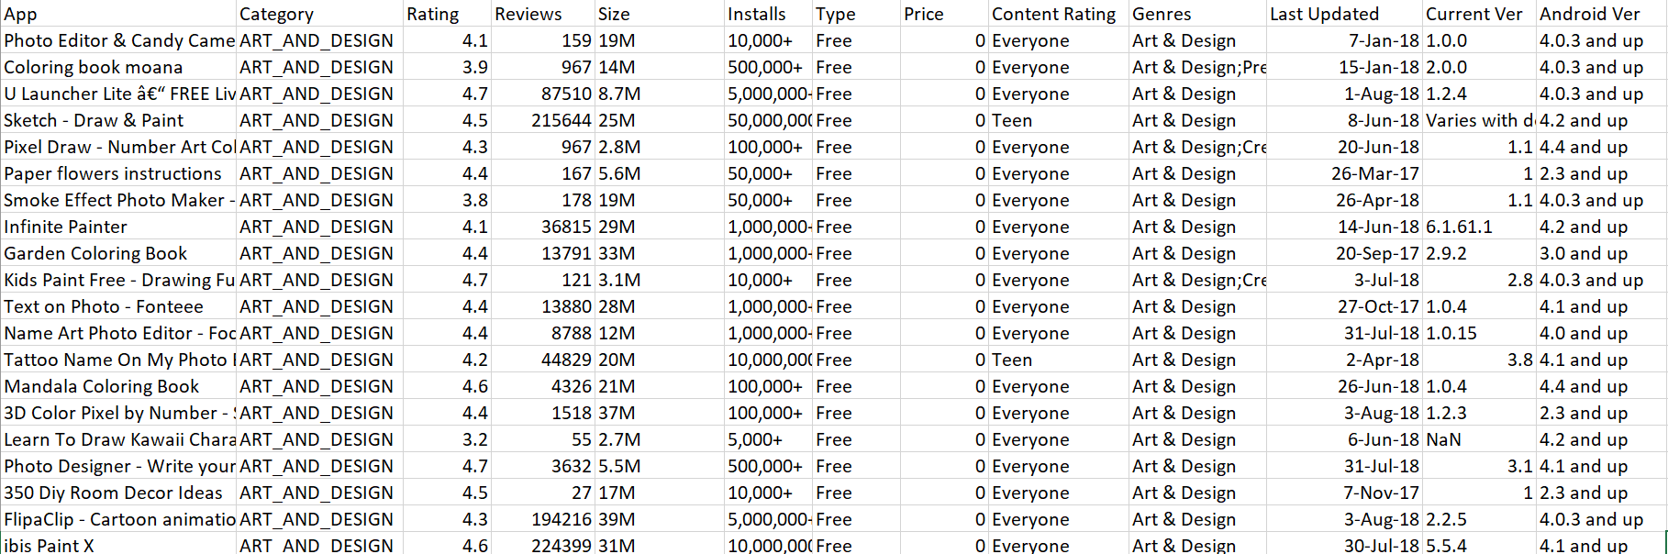

Slide 9
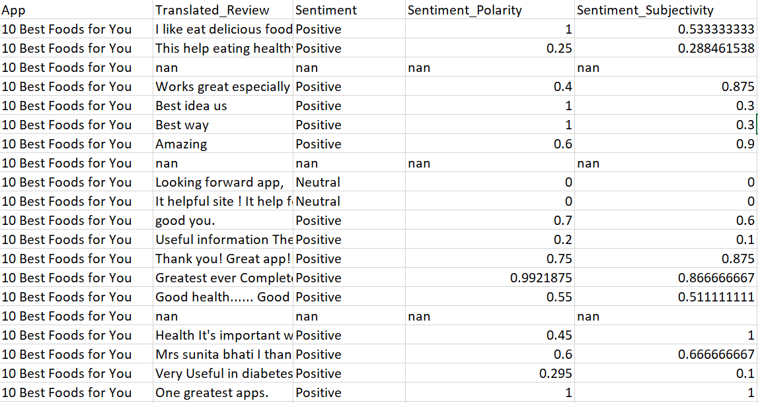

Slide 10
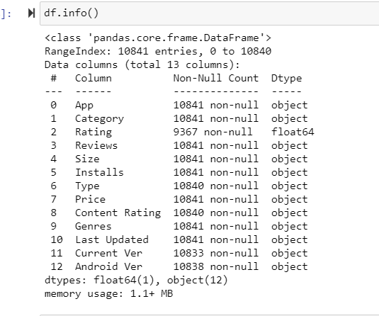
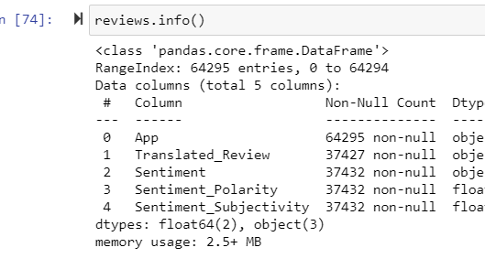
Data Info

Slide 11
Data Preparation

Slide 12
Missing Value Imputation
Real-world data often has missing values. Data can have missing values for a number of reasons such as observations that were not recorded and data corruption
Impact
• Handling missing data is important as many machine learning algorithms do not support data with missing values.
Solution
• Remove rows with missing data from your dataset.
• Impute missing values with mean/median values in your dataset.
Note
• Use business knowledge to take separate approach for each variable
• It is advisable to impute instead of remove in case of small sample size or large proportion of observations with missing values

Slide 13
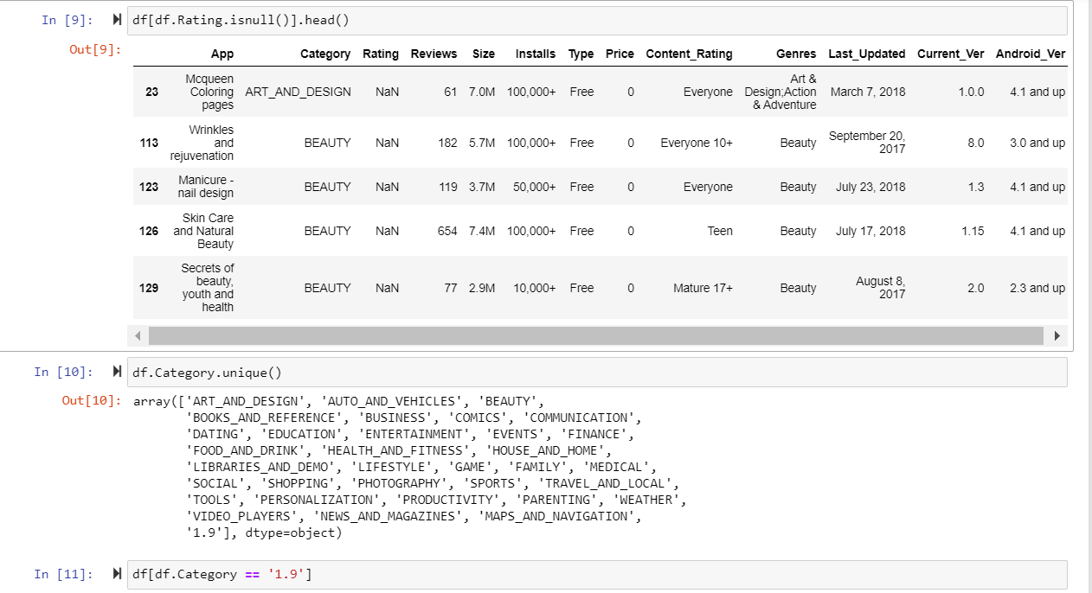
Google Play Store data Cleaning

Slide 14
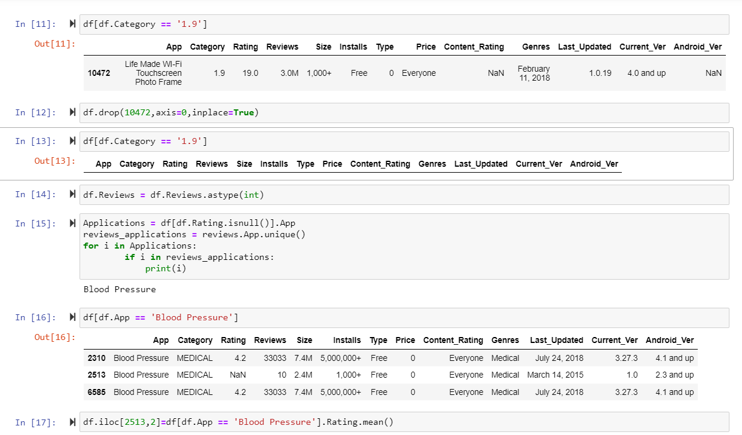

Slide 15
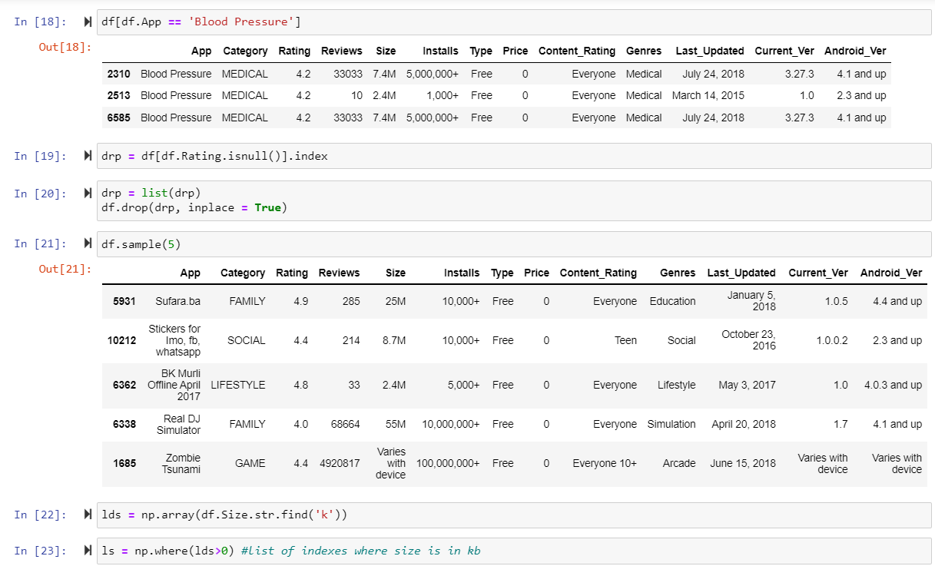

Slide 16
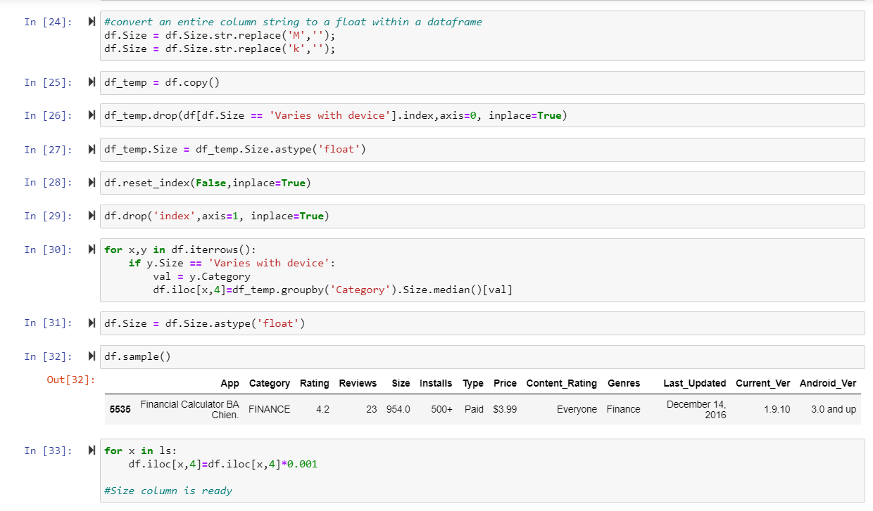

Slide 17
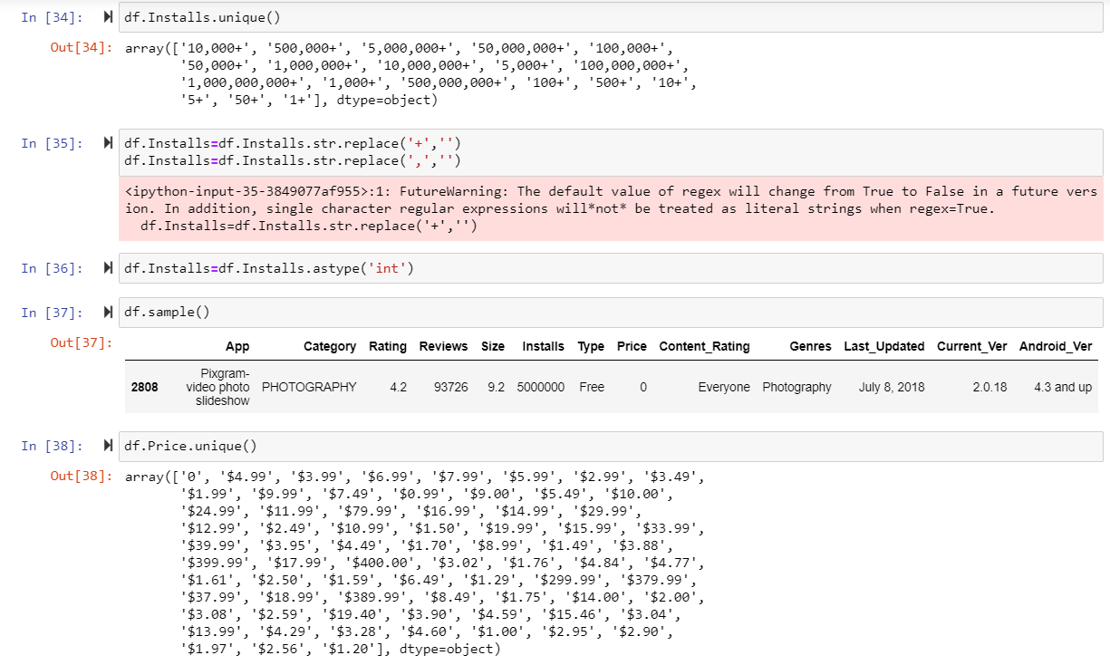

Slide 18
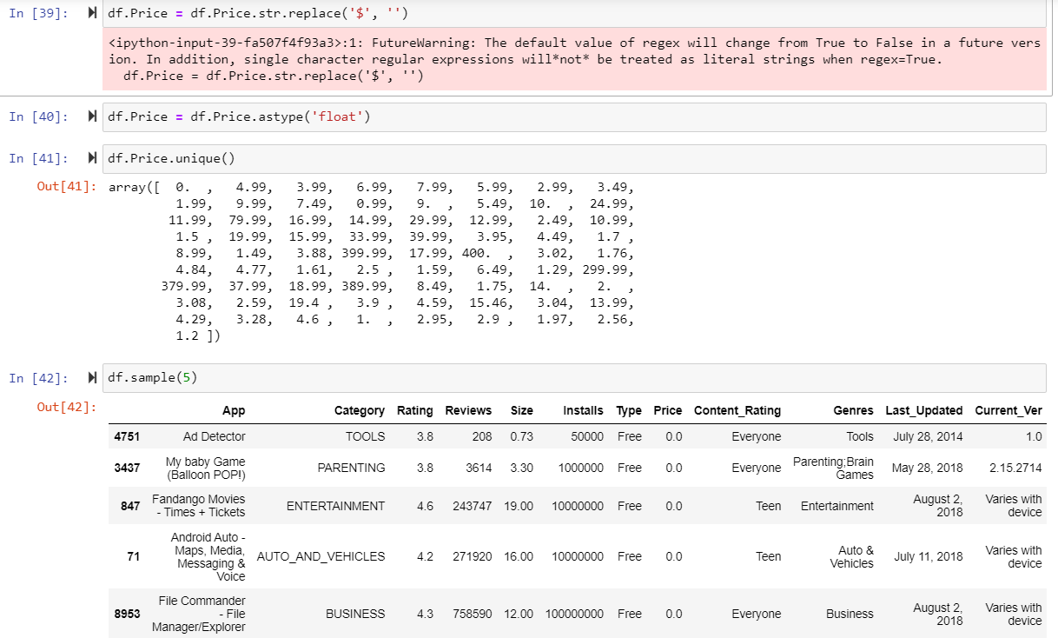

Slide 19
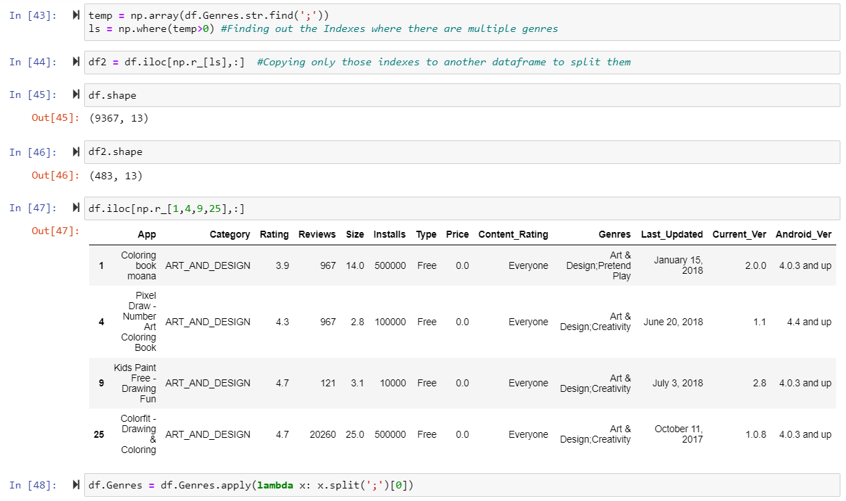

Slide 20
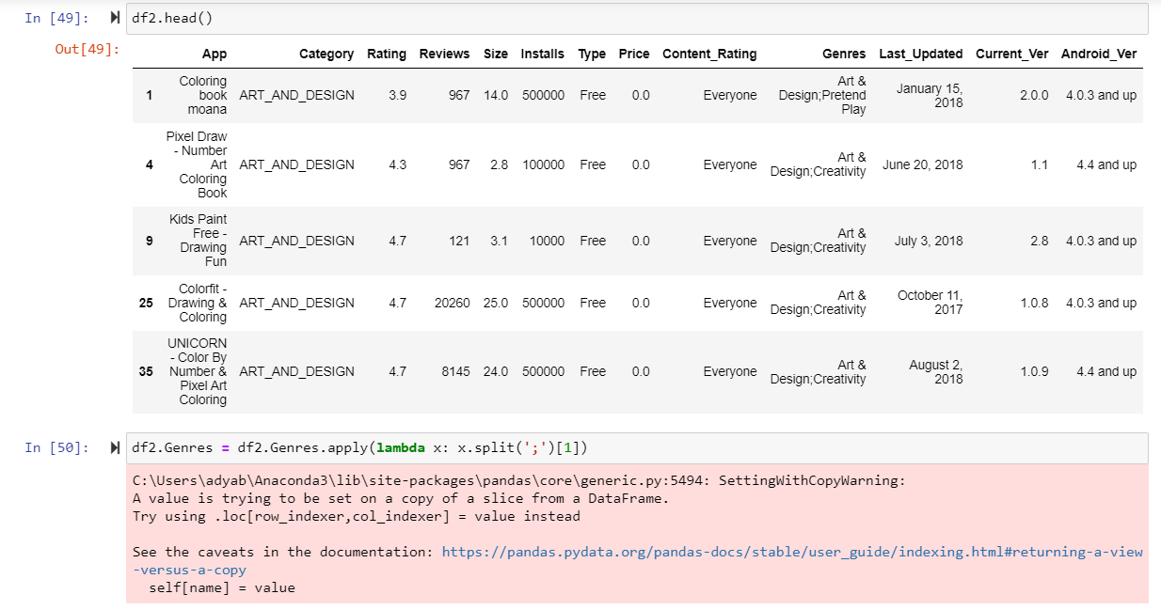

Slide 21
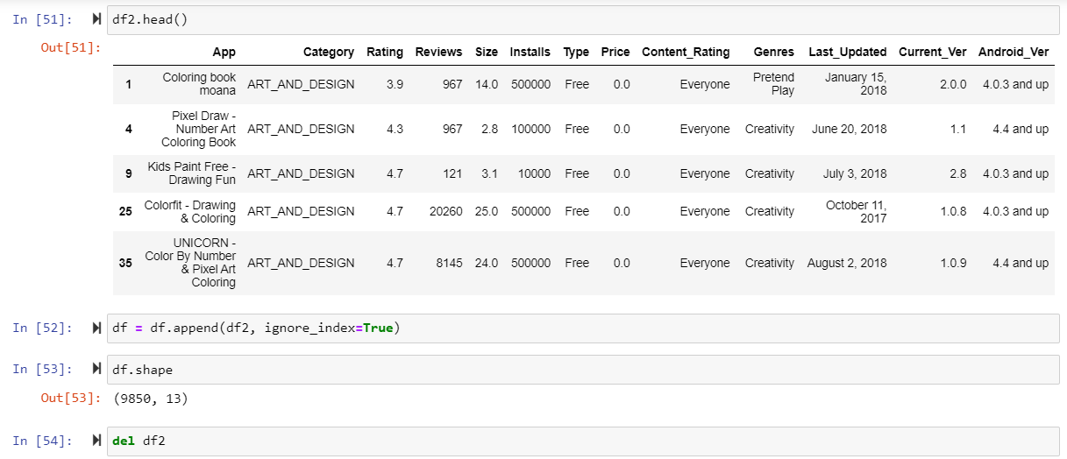

Slide 22
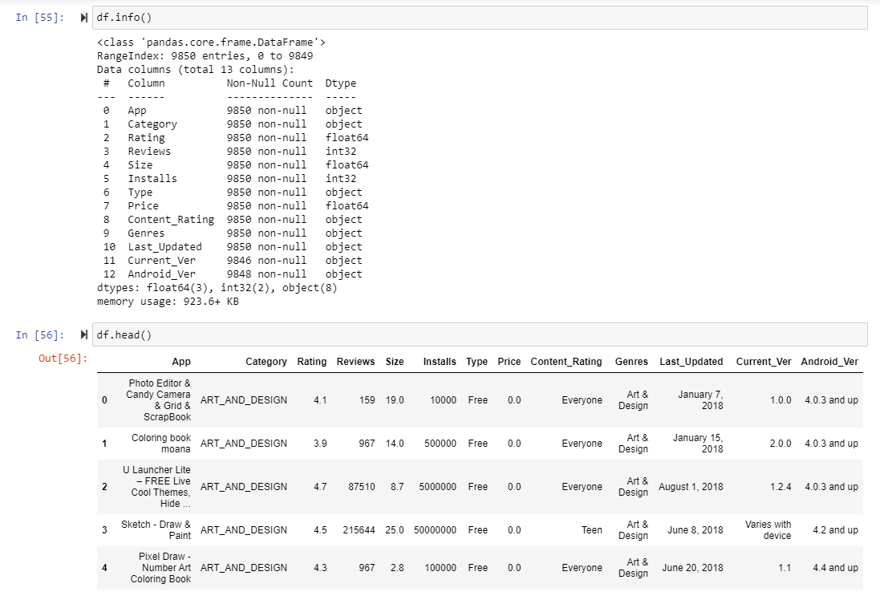

Slide 23
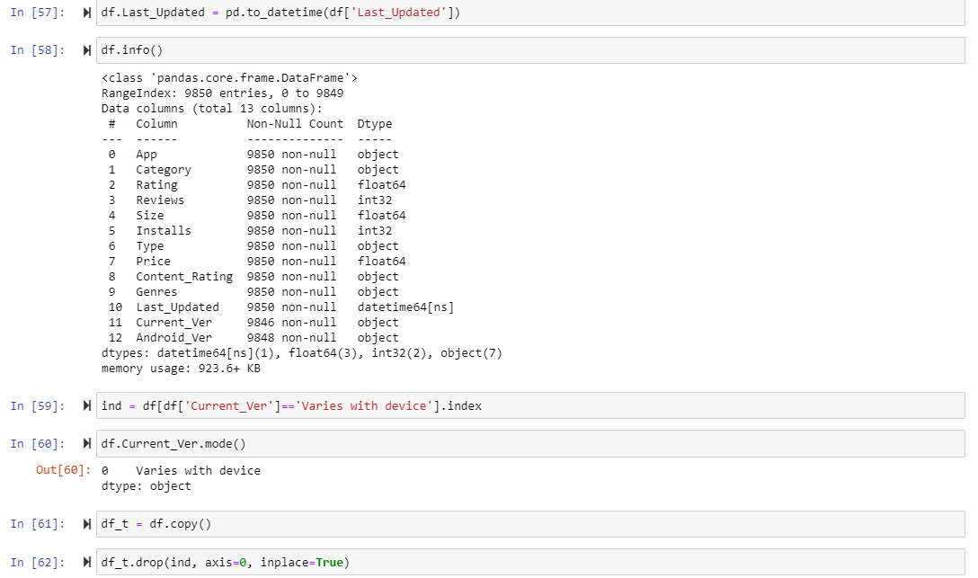

Slide 24
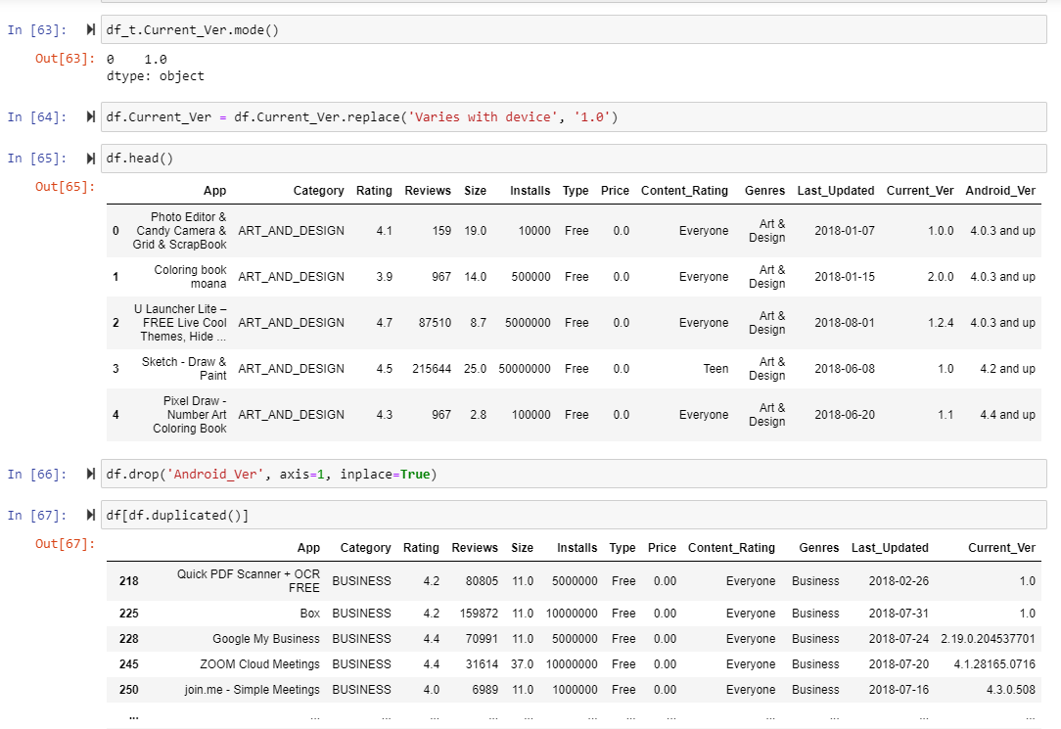

Slide 25
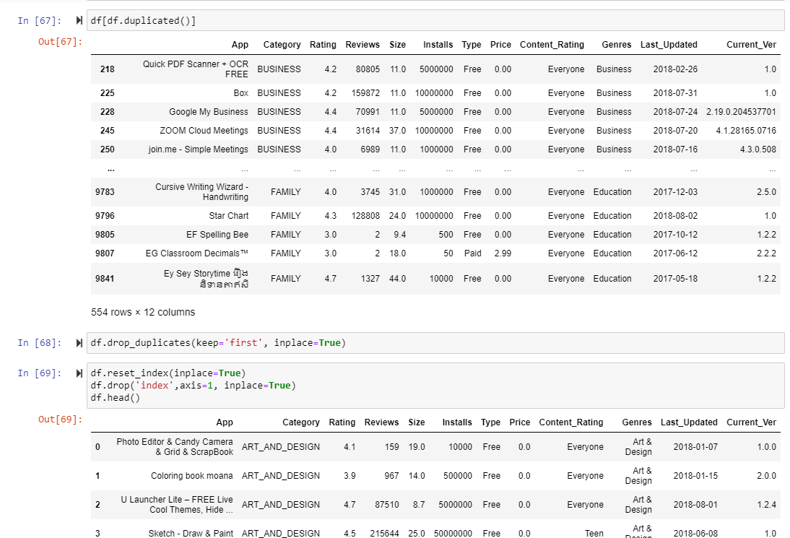

Slide 26
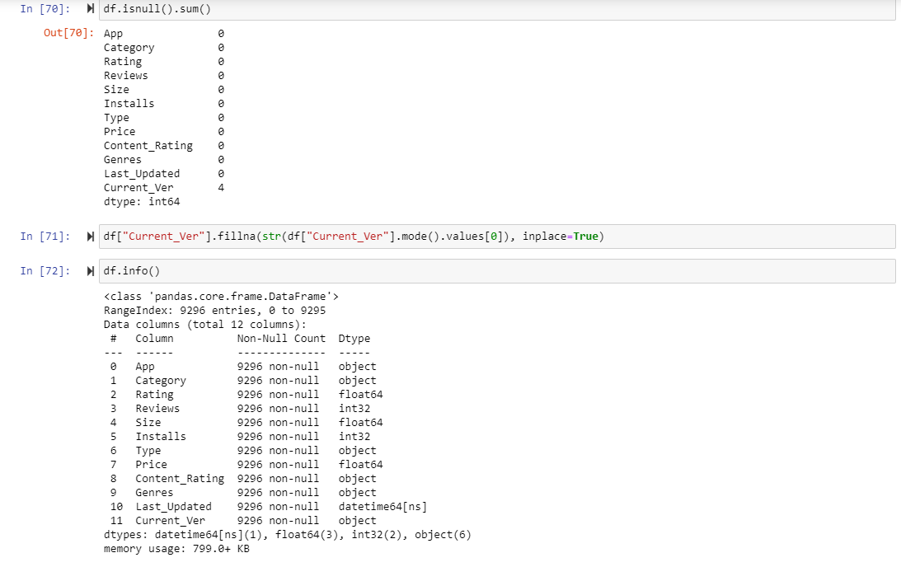

Slide 27
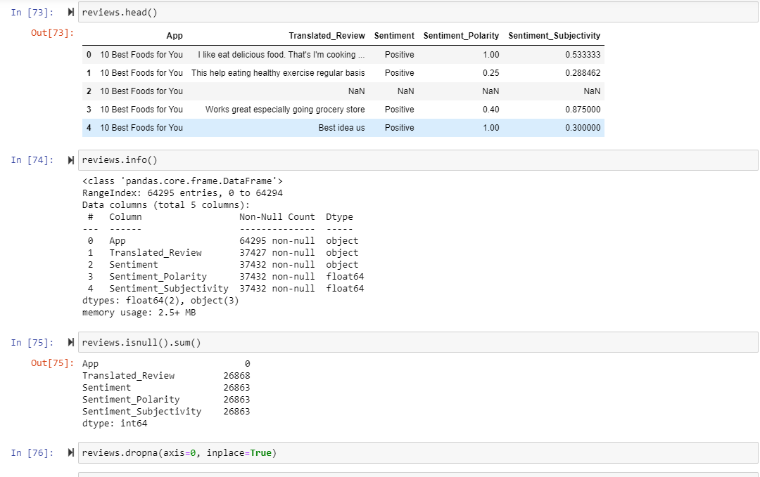
Review data Cleaning

Slide 28
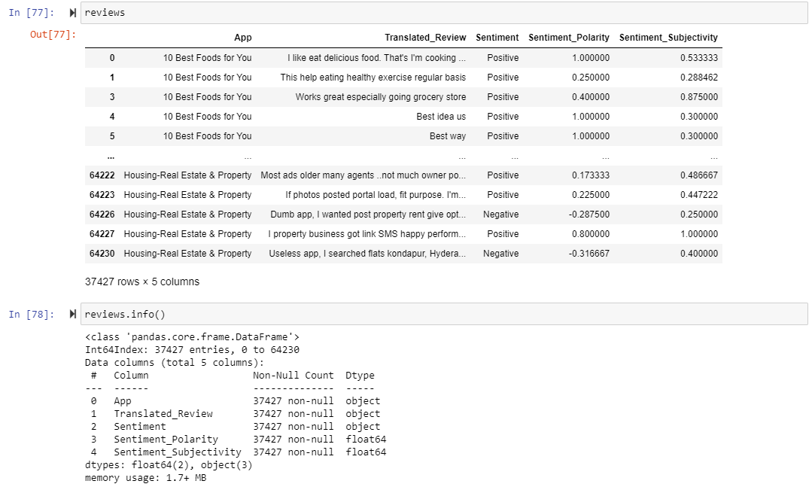

Slide 29
Algorithm Selection

Slide 30
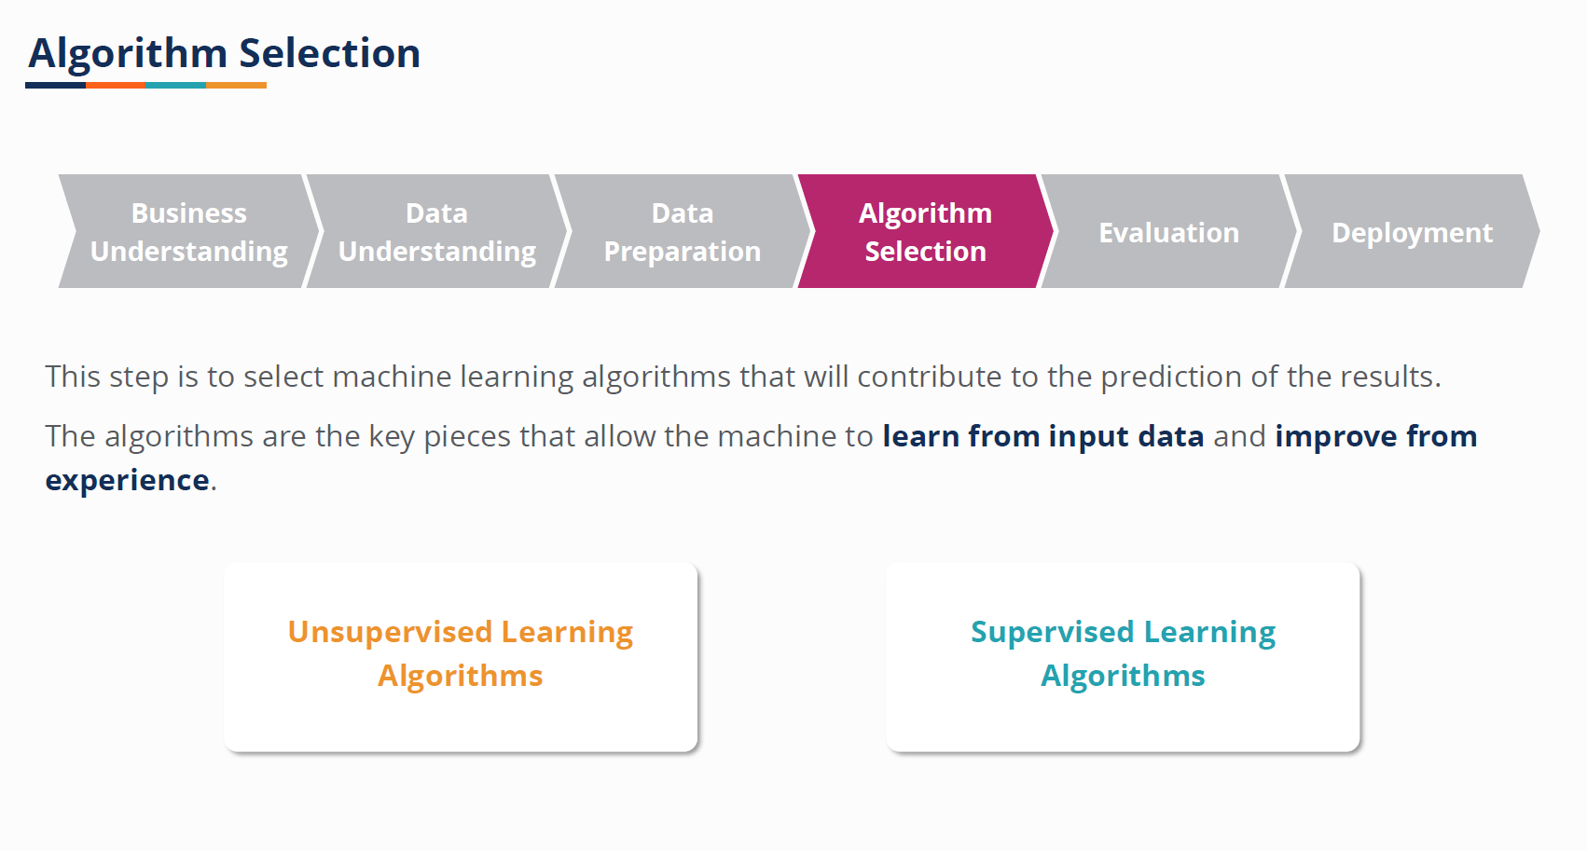

Slide 31
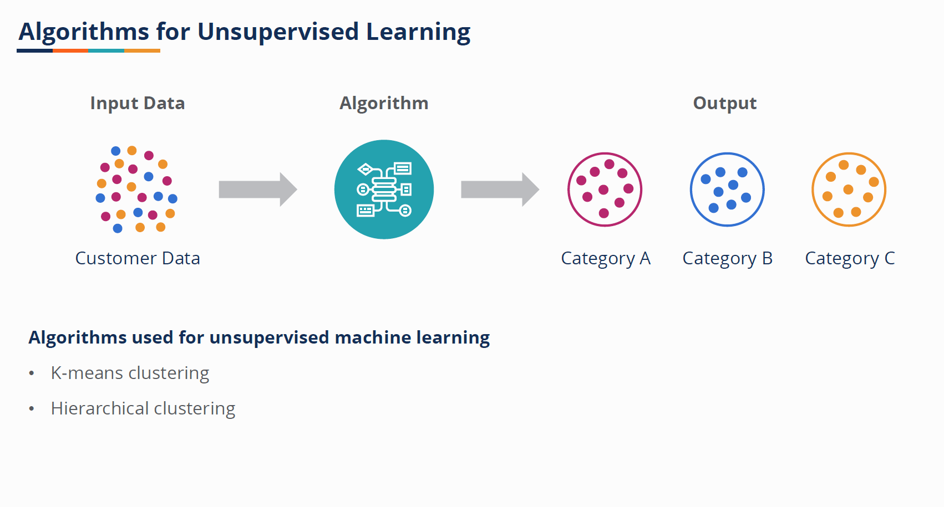

Slide 32
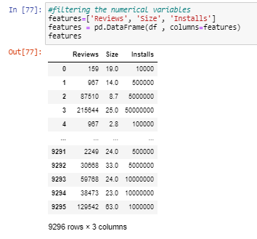
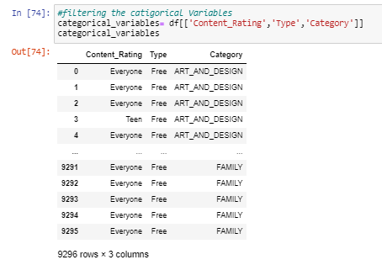
Feature Selection

Slide 33
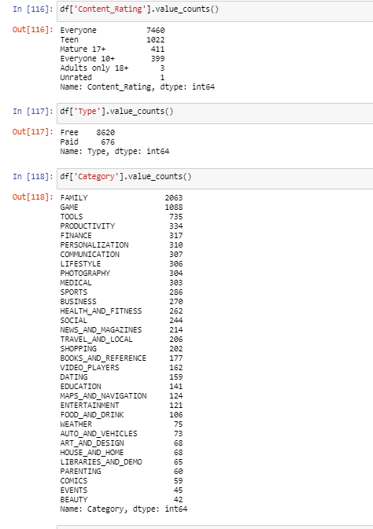
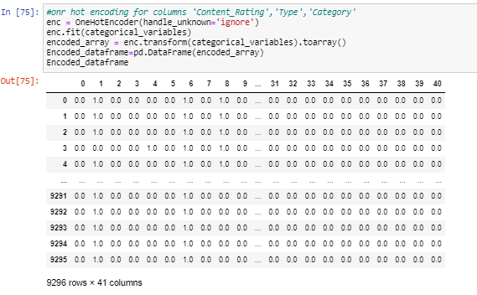
Feature Engineering

Slide 34
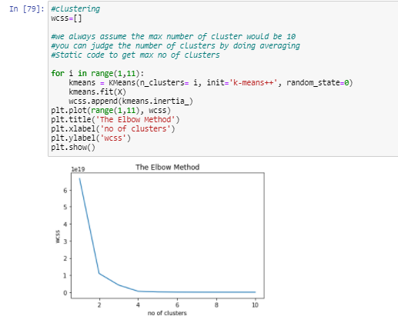
Clustering

Slide 35
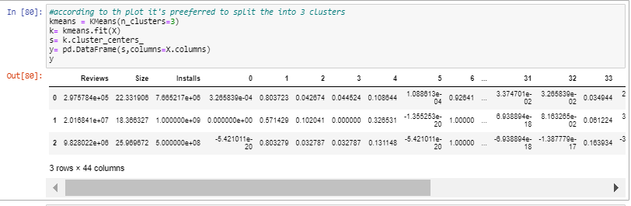

Clustering

Slide 36
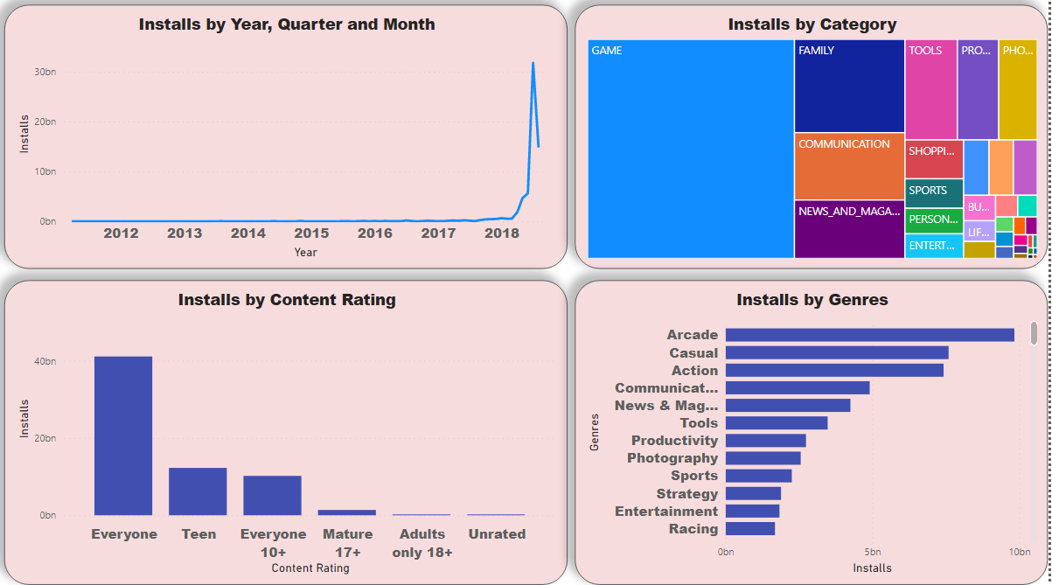
Visualization

Slide 37
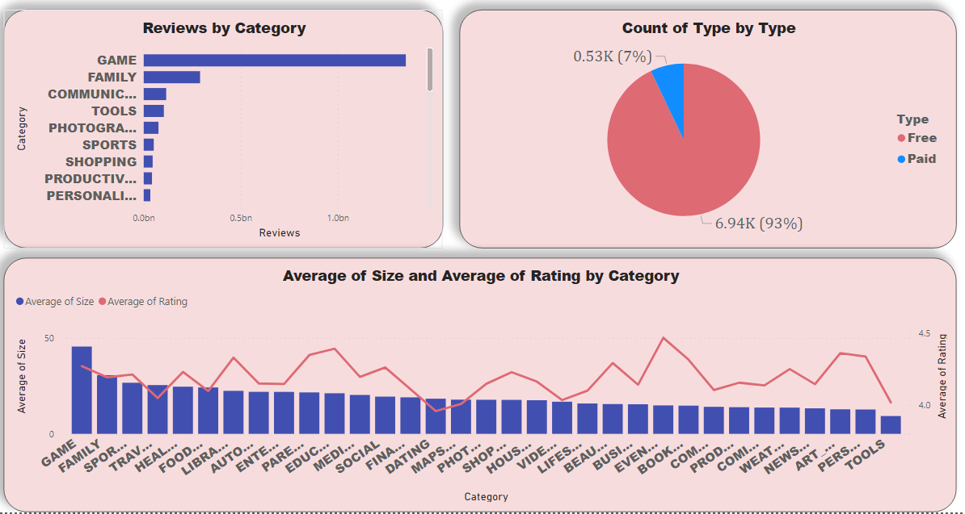

Slide 38
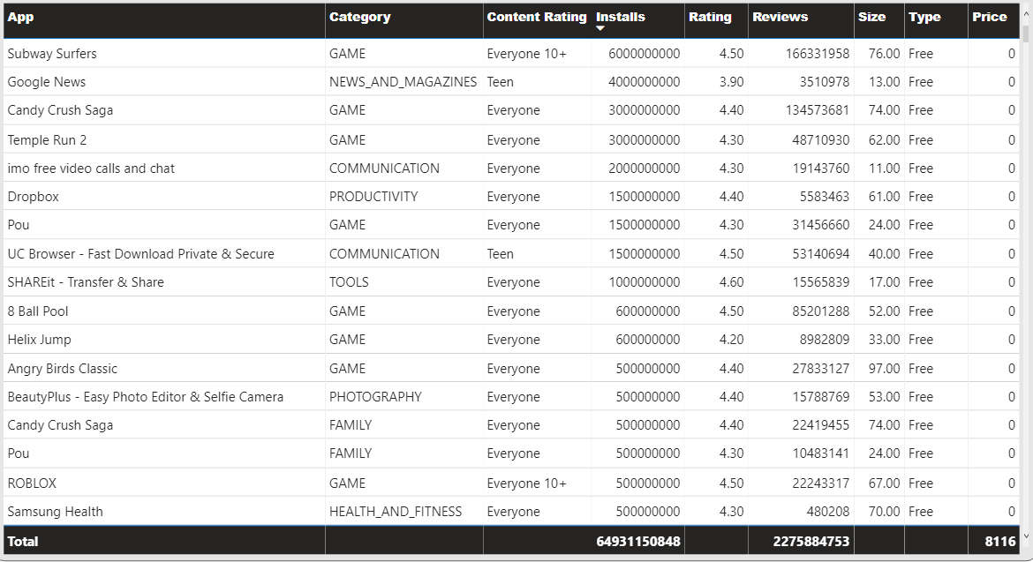

Slide 39
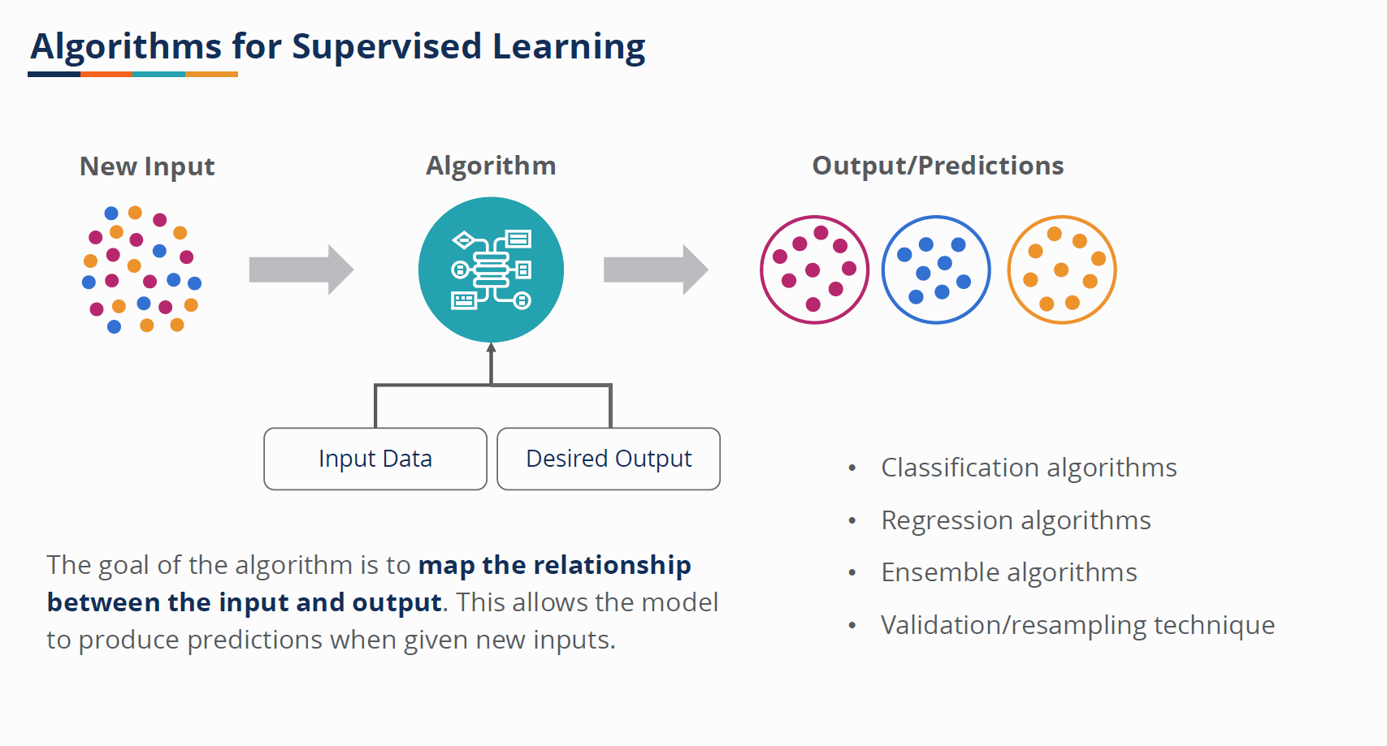

Slide 40
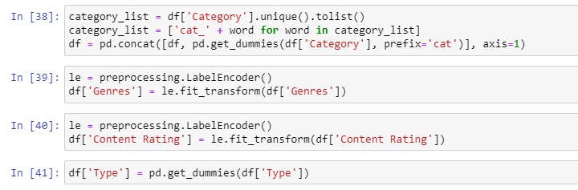
Feature Engineering
Label encoder or categorical data and dummy columns as a data scaling

Slide 41
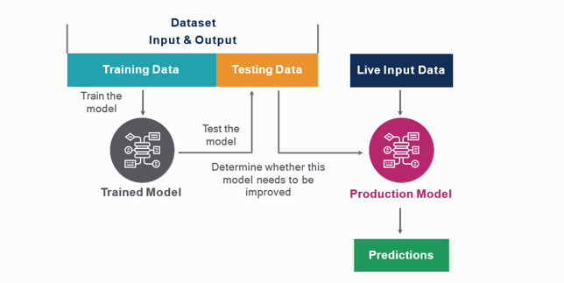
Train Test Split

Slide 42
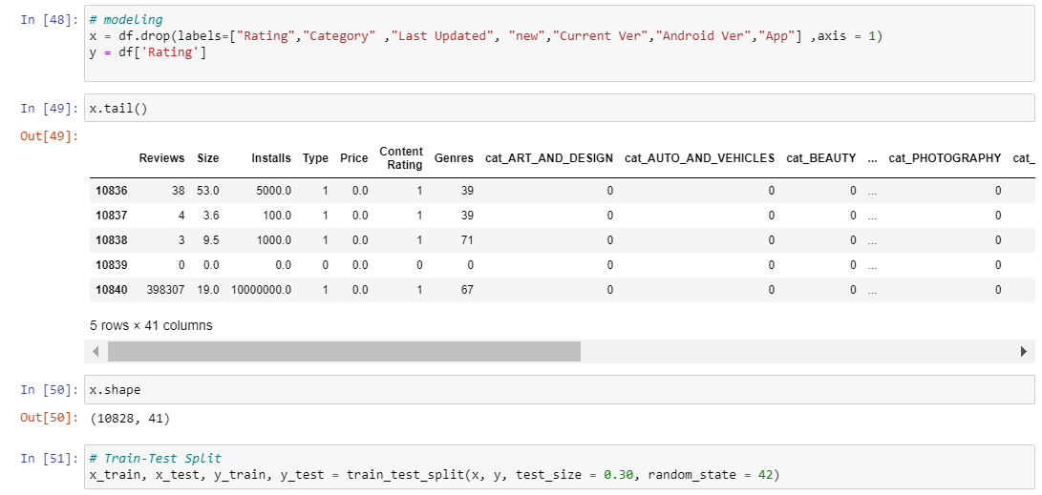

Slide 43
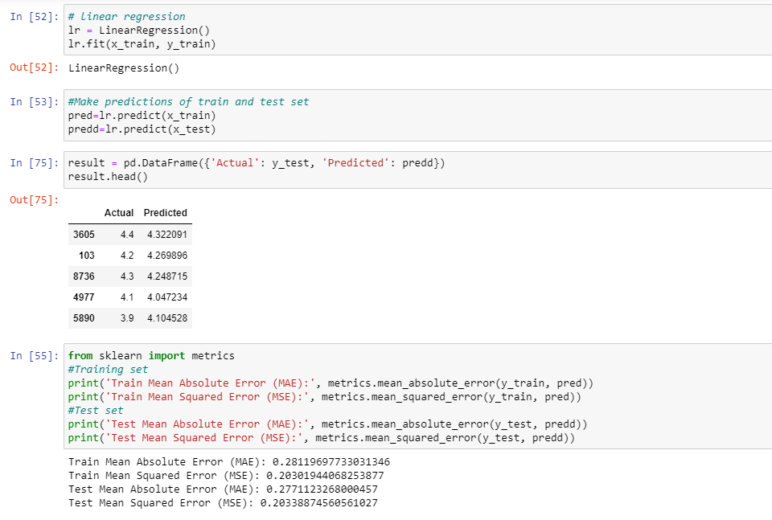
Linear Regression

Slide 44
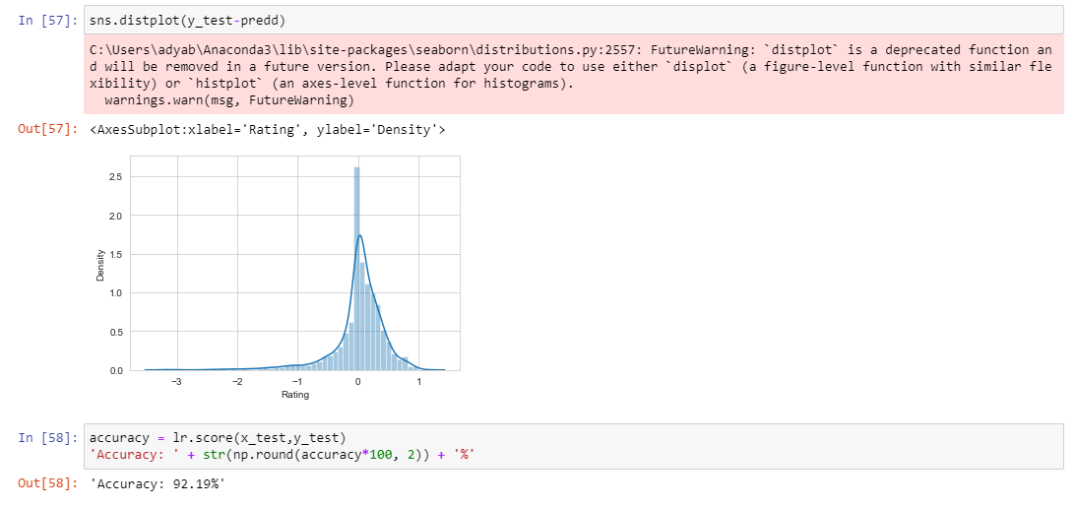

Slide 45
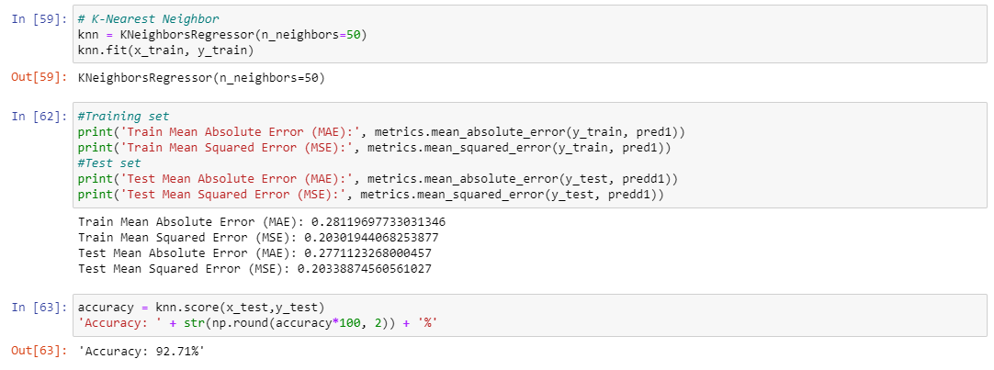
K-Nearest Neighbor

Slide 46
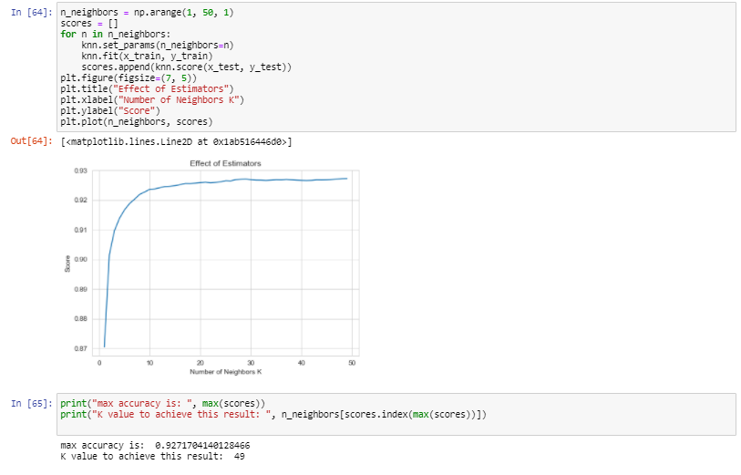

Slide 47
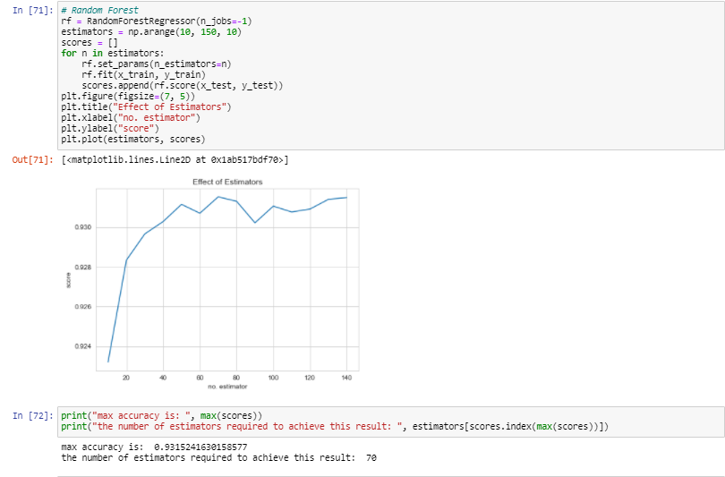
Random Forest

Slide 48
Conclusion:
Unsupervised Algorithm:
Clustering:
Data has been clustered into three clusters

